Slide 1







Dean Acreman – Public Health Wales
Project Manager – Trends in substance use & harm reduction
– WEDINOS

Slide 2


Slide 3
Sources of samples and routes of transportation
Young Persons
Services
Drug services
Housing
Hostels
Education
Local authority
Pharmacy
Clubs/amnesty
POLICE
AMBULANCE
INTERNAL POLICE TRANSPORT MECHANISM
Emergency Dept
NPS Users
HEALTH COURIER SERVICE
LLANDOUGH TOXICOLOGY
POSTAL SERVICE

Slide 4
Analytical Techniques
Primary : TOF-MS (Time-of-Flight Mass
Spectrometry), NMR
Secondary : GC-MS, LC-MS, LC-PDA, UV-VIS
Spectrometry, Melting Point, Chemical Tests,
FTIR

Slide 5

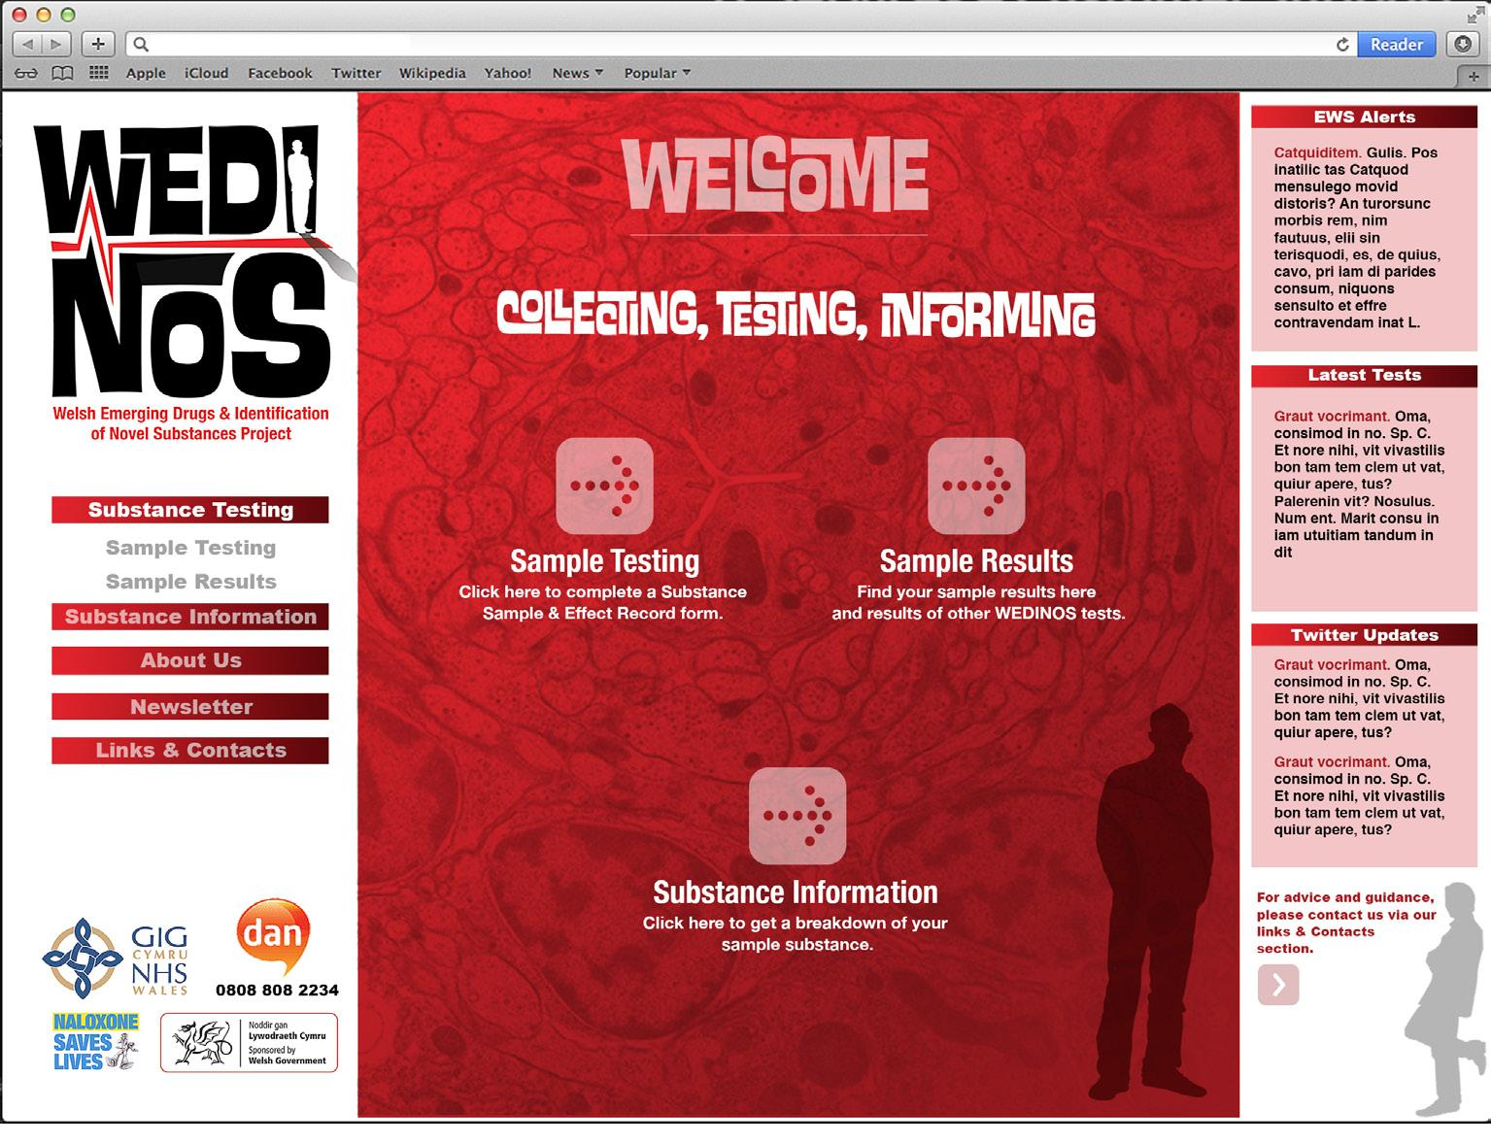


Testing and Results
Notes:
nuclear magnetic resonance (NMR)

Slide 6
Samples to date (1st November 2015)
6,381 samples received
336 substances identified
All 7 welsh health boards and wider UK
All 4 welsh police forces
All 5 welsh prisons
159 services / organisations providing samples

Slide 7
WEDINOS and IPEDs
Anabolic and Androgenic Steroids (AAS)
Substances (licit or illicit) which may be taken by an individual to perceptually enhance the way in which they physically look. As such these may include substances such as diet/fat-loss pills, injectable and oral tanning agents, botox and collagen fillers16..
WEDINOS does not test Human Growth Hormone (HGH), Peptides, Pro-peptides or T3 and T4.

Slide 8
Image and Performance Enhancing Drugs (IPEDs)
1,294 samples received
51 substances identified either in isolation or combination

Slide 9
Ten most commonly identified IPEDs

Slide 10
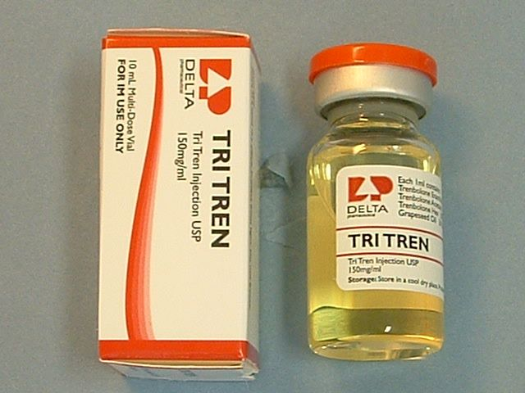
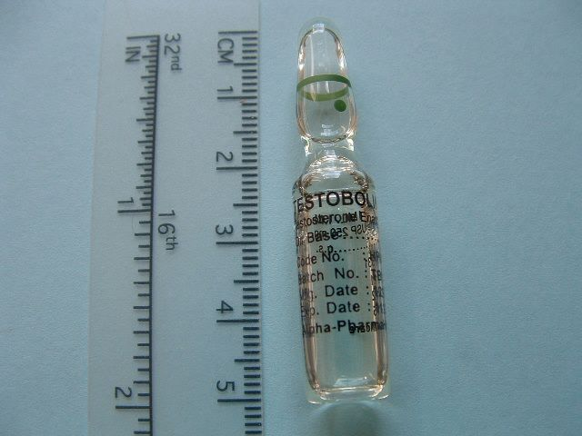
Sources of SIEDs
Pharmaceutical grade
These are manufactured in a strictly controlled and licensed environment.
Veterinarian
These may contain the same medicines as pharmaceutical grade steroids. Manufacturing and
safety standards may be lower and they are not made for human consumption
Underground
These are made in illegal and unlicensed premises. The sterility, content and quality of the
product cannot be guaranteed.
Counterfeit
These are copies. The sterility, content and quality cannot be guaranteed.
Notes:
Facilitator notes:
With all illegally sold steroids and image enhancing drugs, individuals cannot be sure what is being injected. The SIEDs may be contaminated, contain harmful substances, steroids other than those indicated or at a different dose, or no steroid at all.
Data on the quality and levels of contaminants of underground steroids is available from European and US research. One study, undertaken by Bill Llewellyn in 2007 and 2010, focused on 14 samples of steroids made in underground labs. These samples were tested at an independent laboratory in the US. Findings from 2007 indicate that of the 14 samples:
- 21% contained traces of heavy metals
- 64% were under or over dosed compared to the dose indicated on the label
57% contained contaminates (unidentified)
In 2010 - 24 samples were obtained and sent for analysis
- 25% (6 samples) contained bacteria
- 71% (17 samples) were contaminated with other materials. Some of the contaminates were other steroids that were not listed on the label, other contaminants included paraffin and fatty acids
Water based steroids were found to be at greater risk of containing bacteria. This is unsurprising as water is an ideal medium for bacteria to grow
Previous research, undertaken between 2000 and 2004 by Dutch authorities tested confiscated steroids indicated that of the 336 samples seized and tested:
- 57% did not match the label, either dose or content
7% contained no steroid at all
As demand for steroids grow and restrictions on purchase increase, we may well find an increase in the production and distribution of SIEDs through underground labs within the UK.

Slide 11
Geographical spread of samples

Slide 12
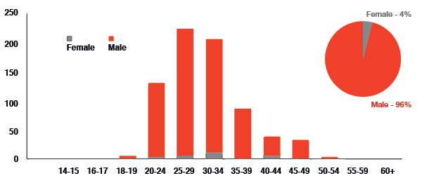
Findings...
94% of IPED samples submitted included demographic.
The median age for all IPED sample providers was 34 years (average age 30 years):
Females - median age was 30 years and average age was 31 (range: 20-50 years)
Males - median was 33 years and average age was 30 (range 17 – 52).

Slide 13
Age of initiation...
Younger age of initiation than other injecting subgroups (Harm Reduction Database, PHW)
Notes:
SIEDs survey (2014) reports 42% of participants using injectable and 43% of participants using oral SIEDs started using by the time they were 23 years old
50% of those accessing NSP services considered new initiates and as such likely to have limited knowledge surrounding safe injecting practice, BBVs etc.

Slide 14
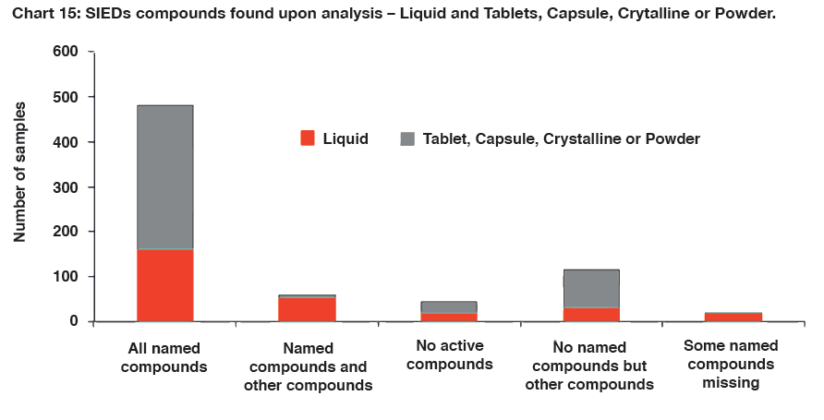
Findings...
67 per cent of the SIED samples analysed contained all of the expected/named compounds
3 per cent contained some, but not all compounds expected/named
8 per cent contained some of the named compounds, but also other compounds
16 per cent contained none of the named compounds
6 per cent contained no active chemical compounds.
33 per cent of SIED samples analysed with purchase intent data were found to be different from what they were believed to be at point of purchase.
Additional concerns include: dosage, contraindications, bacterial content, heavy metals & legal status

Slide 15
The Case of Oxandrolone
Oxandrolone is an oral anabolic steroid.
No significant estrogenic or progestational activity.
Quite mild as far as oral steroids.
Promotes strength and quality muscle tissue gains without significant side effects.
Oxandrolone appears to offer less hepatic stress than other c-17 alpha alkylated steroids.

Slide 16
The Case of Oxandrolone
157 submitted as Anavar or Oxandrolone
8 Substances identified

Slide 17
The Case of Oxandrolone:
Substitution

Slide 18
The Case of Oxandrolone:
Dose range

Slide 19
Testosterone what.....? Why does it matter
Acetate 3 days
Propionate 2 days
Phenylpropionate 4.5 days
Isocaproate 9 days
Enanthate 10.5 days
Cypionate 12 days
Decanoate 15 days
Undecanoate 16.5 days

Slide 20
Samples of Interest
Trenbolone Enanthate = Trenbolone Acetate
Methandrostenolone = Oxandrolone, Oxymetholone & Metenolone
Oxandrolone = Oxymetholone

Slide 21
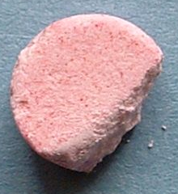
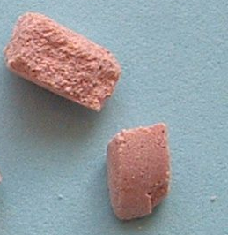
Samples of Interest
Paracetamol
Oxymetholone, Nandrolone hemisuccinate, Methenolone acetate

Slide 22
Dosage and Polydrug use...
Combined use of multiple SIEDs and ancillary substances is common e.g. Human Growth Hormone, Melanotan, Tamoxifen, Clenbuterol, DNP... (SIEDs Survey, 2014)
Dose ranges above therapeutic level. Mean doge range for injectable anabolic steroids being 1.5g testosterone per week, with the largest being 7.5g (SIEDs Survey, 2014)
Average length was 20 weeks, with 27% using a ‘blast and cruise’ approach (SIEDs Survey, 2014)
Wide use of psychoactive substances e.g. alcohol, cannabis, cocaine
Notes:
Dose ranges above therapeutic dose. Natural testosterone production is approximately 60-75 milligrams per week. Evidence surrounding impact of such use is extremely limited
The use of steroids with short and long acting esters for ‘kick-start’ / ‘maintenance’ effect of testosterone production
Use of ancillary substances to enhance/compliment anabolic steroids e.g. reduce water retention, increase growth releasing factors. Also used to minimise unwanted side effects and support Post Cycle Therapy (PCT) e.g. Use of aromatase inhibitors to reduce oestrogen production and in turn gynaecomastia, and use of Human Chorionic Gonadotropin in order to kick start Hypothalamic Pituitary Testicular Axis (HPTA) and natural testosterone production
SIEDs survey reported 31.5% of participants having used psychoactive drugs within the previous 12 months, UAM found 46% having snorted cocaine during the preceding year

