Slide 1
What do young people ask and what do they REALLY mean?
Felicity Snowsill
Linzi Mckerrecher

Slide 2
Digital interventions
Notes:
WHY should we use DI & what evidence shows
Many Interactive digital interventions, few address issues that are important to YP such as sexual pleasure & relationships (scoping review 2015 SEXUAL HEALTH PROMOTION)
Personalised advice (we were ahead of our time!)
Collaboration users, stakeholders, design & software skill of the commercial sector & theoretical expertise and evaluation skills of academia.
On line services are demand led, where the young people are in control and agents of their own change
On going costs can be relatively low and targeting large numbers of people can, in theory be relatively cheap & easy
Digital platforms offer quick, convenient and relatively cheap methods for conducting research (Make it Good)
Can target populations..eg MOT
Is the digital world a safe space – it can be but also creates the illusion of a safe space.. (sexting, CSE, pornography..)
What does it provide for young people - Include comfort, security, friends
impacts & challenges of harnessing this resource. Need to find the balance, to be where young people are at. Use their networks to reach them.
Every day is a school day – but some things remain clear. Young people need safe spaces to get their questions answered ..they always have, to get reassurance and advice about the things that are important to them. They need anonyminity, trust and respect.
Ease of access
Often mismatch between YP behaviour on line where yp freely share personal details & adult concerns about confidentiality & data security
Those safe spaces may be a place (service, school, youth club) or a person or somewhere on line. This more than ever is not something they do...but somewhere they go. It is unthinkable for most young people to NOT be connected in some way and so it makes sense to (as we do in other ways) to use the networks and routes language media that YP are already using.
Young people are confident and constant users of digital technology. Commonly multi task on line (but this also means there are competing demands on users attention)

Slide 3
Notes:
MAKEiTGOOD was a piece of insight gathering for NHS Tayside. In initial small group discussion young people talked about these questions:
What do you need to make a relationship good? What are some of the things that get in the way of the kind of relationship you want? What do you expect from sex? What do you think other people expect from sex?
From these discussions, a number of themes emerged that became online pages that asked young people to tell us more about their experiences when it came to:
Alcohol - Body image + Confidence – Communication – Condoms – Contraception – Distance – Drugs – Family + Friends – Happiness – Honesty – Jealousy – Love + Respect - One-night stands – Pleasure – Porn – Pressure - Safe sex - Social media – Stress – Trust
Insight like this is always valuable, but particularly so when considering using social marketing to communicate key messages to young people (or indeed any population group) about health, including sexual health. One of the uses that NHS Tayside hope to make of MAKEiTGOOD is to inform future social marketing work.
In the meantime, the reports from the MAKEiTGOOD work provide lots of useful insight from young people that can help inform services that help young people navigate their personal relationships. This session and 3 others on the menu of sessions intend to share learning and support you to reflect on what might be useful in your setting.
As this slide says: Rather than viewing young people’s relationships and sexual behaviour as problematic MAKEiTGOOD has been framed as open, positive and non-judgemental, seeking to engage young people in a conversation about what makes for a relationship (which might be sexual) that is good.

Slide 4
Drugs & alcohol
Parties, drunk, sex, problems, arguments, domestic abuse, confidence, wild, fun, exciting, dangerous, good time, risks, no condom, stupid things, regret, mistakes, consent, health, jealousy, volatile, sober sex, addiction, bad, chill out, freer, trust, ruin relationships, problems
Notes:
Drugs & alcohol
Both these themes were part of the online consultation – but many of the issues highlight the wider vulnerabilities of young people.
For young people alcohol is stronly associated with having fun & feelings of freedom & confidence
Young people’s insight pays attention to the down side of alcohol in the context of relationships. They identify regret & coercion as powerful considerations. This may highlight lack of self efficacy, vulnerabilities, poor understanding of consent in their emerging understanding & experiences of personal relationships
Views on drugs are mixed – linked to enjoyment & partying with friends rather than being considered in terms of intimate or sexual relations. Drug use is seen as undermining trust, making a partner less reliable.
Drug use is associated with risky sex…but the relationship is complex
Poor or ambivalent attitudes toward condom use and increased partner numbers are associated with drug use but research indicates that rather than being a causal 9 relationship – i.e. an individual uses drugs and does not use condoms – it is a young person’s longer term use of drugs that might indicate a propensity toward risk taking that might lead to increased partner numbers and reduction in the likelihood of using condoms in these sexual encounters

Slide 5
A safe space to ask questions
Notes:
Work with the person not the topic

Slide 6
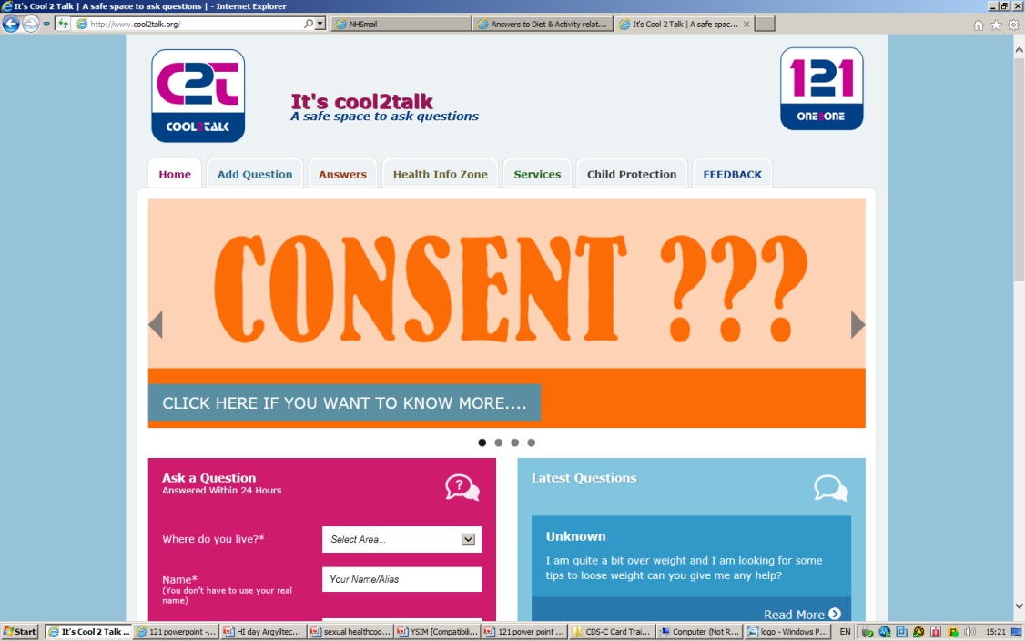
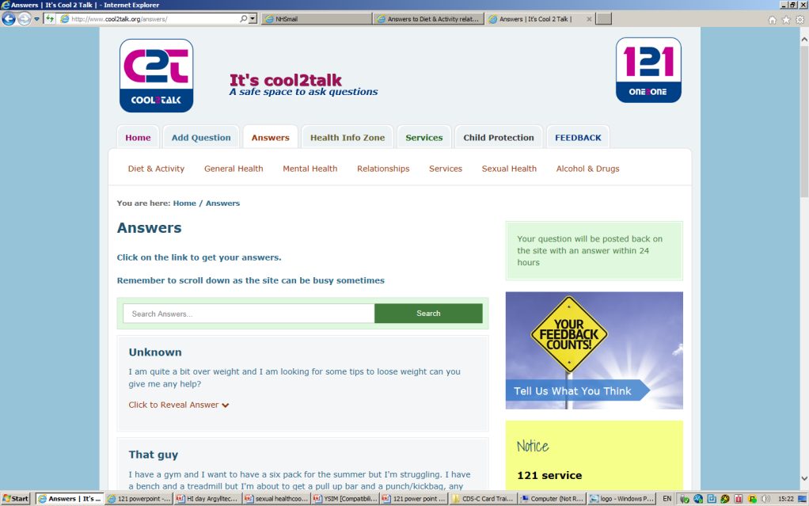
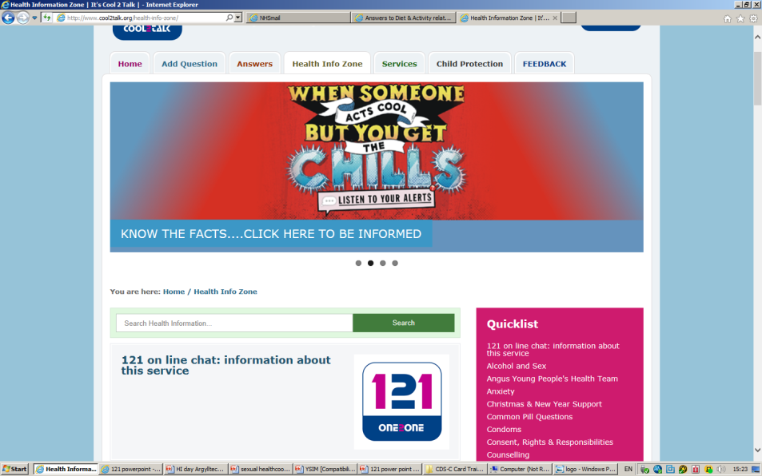
Notes:
How pioneering cool2talk was when it was started 10 years ago. Undergone a few face lifts, but remains simple – tin of beans. It does what it says on the tin.
YP post a question and get an answer
Cool2talk an interactive web site where young people in Tayside can get health related questions answered honestly & correctly. It offers young people reassurance, encouragement, information & advice on any health related issue as well as sign posting to appropriate services.
It offers a first step to getting help in situations where many young people may fall through the net because they are too worried or scared to talk to someone. Promoted to let young people know that they can ask questions about anything
It is not a chat room or e-mail service. Users access the site through the internet – www.cool2talk.org.
questions and answers are posted onto the site so that everyone can read them. All qu are answered within 24 hours
Important link to other appropriate & accessible services for young people. Through networking with services, able to sign post YP.
On site there is information & weblinks on local services, a health infozone & a facility for posting questions & feedback on the site.
Yp are asked for basic info. For monitoring & evaluation

Slide 7
Expanding the service
121 online chat with a counsellor
Notes:
The way that young people use technology has changed rapidly and there have been requests from young people for an on line chat facility. Young people would receive anonymous support and answers to their questions in an instant messaging facility. Using the benefits of digital technology we can enhance an already well used and credible service.
Evidence shows that on line therapy gives people
more choice about how they engage with support services. On line support has a level of anonyminity that transcends class, gender and race to make for a neutral environment that can either increase the building of rapport or increase the perception that rapport is building.
Qualitative research shows that young people prefer to use counselling on line because of the anonymity, it makes them feel safer and they can hide their emotions giving them a shift in power dynamics.
Young people can make a positive informed choice about using the service, rather than by referral, meaning that they are more open to the options and support provided. On line services are demand led, where the young people are in control and agents of their own change. They receive an immediate response to the way they are feeling in real time.
Wide range of topics that reflects questions asked on cool2talk– will look at this in next section

Slide 8
YOUNG PEOPLE’S
VOICES
Notes:
8
Above all cool2talk represents young people’s voices. Over 25,000 young people have posted questions on the site over the last 5 years. This provides an extraordinary data base for professionals on the current issues that affect young people, and have come directly from young people. As a resource it often shows trends in areas.
For young people the site provides reassurance and many young people come on the site to read the questions only. This is reflected in some of the Talkback comments. This re-enforces normality and that many young people are worried about the same things.
Smarter about integrating site into other services & promotions. Eg syphilis campaign, teenpre & yp strategy consultation, promoting NeedTayknow….with updating site….
8

Slide 9
Last 16 months
3657 questions posted
75 feedback comments.
29,988 sessions on the site, 52% of which were returning visitors
The split between boys and girls remains 3:1
The site is reaching young people from all areas across Tayside and the Western Isles (equity of access)
Highest usage in 14-16 year age bracket
Notes:
9
9

Slide 10
Notes:
10
10

Slide 11
Themes & Feelings
Isolation & Loneliness
“Different”
Anger, sadness, depression
Worthless or insignificant
Confusion
Notes:
Using questions we’ve picked out some themes that are apparent in what young people are asking.
It can be suggested that these themes tell us more about the vulnerability of the young people using the site than the topics do.
So, for example, in the previous slide it appears that drugs and alcohol are a very small percentage of the questions asked.
What we find is that drugs and alcohol may run through lots of the other topics too, particularly those relating to mental health, sexual health and relationships.
This highlights the often complex and confusing situations young people can find themselves in and the multi-faceted nature of the vulnerability of the young people we support.
We also have to remember that they are empowered and confident enough to seek help.

Slide 12
“I needed someone to talk to coz I can’t talk to anyone else. I was staying at a friends house and her boyfriend was there too…we all fell asleep….there was a pillow separating me and her boyfriend. I woke up & something didn’t feel right….her boyfriend was jerking off so I’m there freaking out. And the next thing I know he’s on his feet leaning right over me. I absolutely freeze, I couldn’t move and then I have the idea to role over so I do and he leaps away. I’m still really freaked out”
Notes:
Themes of isolation (no-one else to talk to) and fear – what is she scared about? Someone else’s behaviour, what could have happened, friend finding out?
Impact for the future, how will this affect her relationship with her friend? Socialising with each other?
Dual vulnerability. Young female who didn’t know how to deal with this situation (a confidence issue? expectations?) but also young male who put himself in danger of being caught, labelled, potentially even more serious consequences if this girl had chosen to deal with this differently.
Extra dimension in some questions around unwanted sexual contact around filming/photographing on phone. Increased vulnerability around sharing, victim blaming, future repercussions, lack of control over images. Even if pictures are consensual, sharing usually isn’t. Who do we focus on?
Gender/cultural expectations may impact on females in particular telling anyone about this kind of situation

Slide 13
“I feel so.. idk... helpless? Its just that i smoke a little and i wanna stop. But i cant. I wanna have a great life but i cant achieve that while i smoke…am scared shitless of getting found out but at the same time everytime i get told to not do something, for example, smoke or drink energy drinks, i do it. Mainly to show my parents they dont own me. I feel like when u smoke with other smokers i belong somewhere. But i wanna belong to someone without having to smoke. Idk... i will admit i am "trying to be cool" Then i feel more worthless and self harm.
Notes:
Themes around pressure and “fitting in.” We hear lots about peer pressure, we often forget that a massive part of this comes from within and perceived ideas about what people are doing/should be doing rather than the reality. Trying to find their place.
Conflict – scared of being found out but still desperate to assert independence and challenge authority. Something we think is a rite of passage for young people but can forget how problematic this can be. Talks about self-harm at the end of the question. Something we’re hearing about more and more often. Most of the time we don’t hear about the complexities surround self-harm, just the fact that a young person is doing it and usually wants to, or is being asked to, stop.
Indicative of wider pressure around for young people – relationships, identity, feelings, exams, career choices. In 2015 ChildLine Scotland reported that counselling sessions with 12 to 15 year olds on self-harm had increased by 20% in the last year.
Most recent report from The Children’s Society(The Good Childhood Report 2016) suggest that at 10 boys are more likely than girls to suffer from mental health/behavioural issues, this is reversed by the time they hit 14. Some debate about whether this is accurate, are boys just less likely to cover up their feelings and not seek support? – we have more females than males asking questions on the site, but a more even male to female ratio accessing the site over all. Highlights that males still need information, but maybe seek it a different way.

Slide 14
“I am so fed up! I just want to die! The last year, I ruined my life. I met some stupid boy and let him change me! My grades dropped, I did drugs, I drank alcohol, I lost my virginity, I lost all my friends, I started smoking, my parents hate me and I hate who he made me become. I just want to die because I'm worthless”
Notes:
Themes of regret around choices. “Let him change me” – guilt and responsibility. Making choices based on other people and nor having the skills to negotiate this on own terms.
SALSUS tells us that alcohol is most likely to be drunk at a party (52%) or at someone else’s house (44%.) Something unmonitored by adults., increased vulnerability as less likely to discuss relationship issues. Angus Women’s Aid Research 2015 – 20 % of young people experiencing emotional abuse in an intimate partner relationship – usually only recognised after the relationship has ended. Higher rates of females than males.
Was losing virginity consensual? -
Links to alcohol and sexual violence (Home Office 2004) and alcohol and riskier sexual behaviour. Make It Good, Female, 16 “Pressured into having sex with someone I didn’t want to but being drunk made me vulnerable.” However this relationship is not always clear cut: other factors may include young person’s self-esteem, performance at school, general attitude to risk etc.
The flip side of this is the lack of information young people have around pleasure. “Missing discourse of intimacy” Paul Byron 2016 (“The Intimacies Of Young People’s Sexual Health & Pleasure”) May have been a positive, consensual choice. Now listed with all other regretful behaviours (messages give to young people that sex should be “special”, about love and not pleasure, now relationship has ended sex is seen as something she “shouldn’t” have done.

Slide 15
Hi. I was just wondering if you would answer a few questions I have about sex etc. I'm still a Virgin but I was just wondering, 1) when you have sex does your vagina need to be shaved? 2) How do you know If ur hole isn't big enough for sex 3) how do you have sex, 4) will it hurt? 5) what's the best way to go about? 6) should I have a one night stand in case it's embarrassing 7) how do you do a blow job and a teabag? Please answer these thanks in advance
Notes:
Thought it important to use this question as it highlights some of the additional external pressures on young people around sexual behaviour.
We have had an increase on the site of questions around shaving pubic hair. Young people are absorbing messages about sex and relationships from our often very sexualised culture, but don’t always have someone to get the right information from. Normalised porn culture and changes in expectations. Why does she think pubic hair has to be shaved? Current culture dictates this is the “norm” but where do these ideas come from? Many questions ask if pubic hair is dirty or how to continue shaving even if it’s sore or causing ingrown hairs. Importance of public image (the one people/partners see or the one that’s discussed) over personal comfort. Clear messages about pleasure (or lack of) from a female point of view. Lots of uncertainty about pain, how she appears (worried about “performance” and embarrassment) but a desire to carry out sexual acts for males well.
In 2015 a report for the Guardian found that 60% of school and university students watched porn to get information and knowledge about sex. What information are they getting? Current survey running on Survey Monkey is a missed bag. Many young people seem to be aware that what they see in porn isn’t real – but still think it impacts on body image (of self) and expectations of and from others)
Also indicates a lack of confidence around communicating with a sexual partner. Thinking about having sex but unable to chat about this. If young people cannot negotiate sexual conversations with a partner or potential partner it can leave them vulnerable. They may not be able to outline boundaries or talk about what they do or don’t like.
Identifies a need for young people to be given the skills to engage in meaningful discourse about all behaviours that affect their wellbeing, ranging from sexual relationships to drug and alcohol use, without fear of judgement.

Slide 16
Risk & Protective Factors
Risk factors
Parental influence
Family-School-Community
Aspirations
Peers
Protective Factors
Parental influence
Family-School-Community
Aspirations
Peers
Fairness, closeness, belonging, feeling wanted, positive conflict resolution, peer influence, parental involvement in school & social life
Low income, poor housing availability of substances, appearing older, family history of problem behaviour, drug use & normalisation
Not Static
Notes:
The kind of things that influence yp engagement in risk taking behaviour

Slide 17
Response:
The person not the topic
Notes:
17
17
Often all young people are looking for is a personal response & some reassurance. Many questions are answered in one go. Other questions need more – either referrals or more information & a building of confidence & trust that there are services out there to support people.

Slide 18
Listening to feelings, counselling response
Building of confidence
Reassurance on what is normal & what isn’t
Stepping stone to other services (partnership work)
Child Protection
Resource

Slide 20
The reply I got from this site has made me feel so much better. Just knowing that someone is out there that would listen to my problem and try to help, helped me in itself. This site is wonderful. Thank you so much.
Notes:
20

Slide 21
Thanks for your help, cool 2 talk. I recently asked about how to cope with my anxiety, depression and self harm. Your help was fantastic and it felt great to have people to rely on when times got too tough. I am very thankful to have this service.

Slide 22
Felicity Snowsill
fsnowsill@nhs.net
Linzi McKerrecher
lmckerrecher@nhs.net
Notes:
22
22

