Slide 1
Working with Young Men:
Young males’ experiences of loss, trauma and bereavement
Nina Vaswani, Research Fellow, Centre for Youth and Criminal Justice

Slide 2
Gender-informed practice

Slide 3
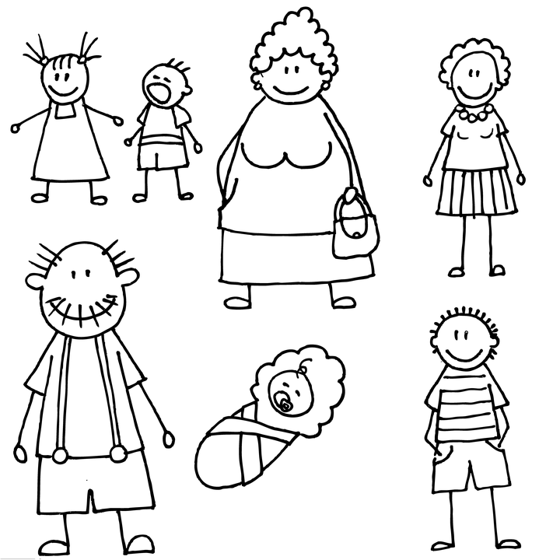
Bereavement among young people involved in offending

Slide 4
Bereavement in Polmont YOI

Slide 5
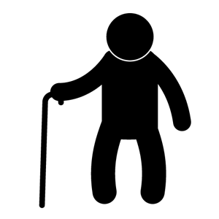
Bereavement in Polmont YOI

Slide 6
Bereavement in Polmont YOI

Slide 7
Bereavement in Polmont YOI

Slide 8
Young men’s words
I was thinking about like ‘how many more people do I have to see die? Am I gonnae grow up and see everybody die off?’ know what I mean? That was the way I kinda felt, I’m only 19 and that’s five people died already and I keep thinking to myself ‘are the rest of them gonna die?’ know what I mean then I’ll grow up alone.

Slide 9
A catalogue of losses
A range of losses:
Loss of relationships
Loss of status
Loss of stability
Loss of future
Ambiguous losses
Disenfranchised Grief

Slide 10
Young men’s words
…my daughter dying and my brother dying…my sister getting raped…being in care my whole life, just lots of stuff, my mental health…
.
Obviously my father’s been in prison for nearly five years and I’ve got nobody to follow by, no role model so I had nobody…I’ve got a Mum but I don’t class her as a mum because I don’t feel like I’ve had a mum.
.

Slide 11
The impact of loss and bereavement on behaviour
Sadness, shock, anger, numbness
Common reactions
Resilience
Problematic scenarios
Substance misuse
Risky sexual behaviour
Self-harm / suicide
Increased risk-taking

Slide 12
Young men’s words
I just didnae bother with anything, even the police they didn’t scare me, they didn’t bother me anymore
.
I’d no been in prison before but after my Gran died everything got worse just from there, I just started drinking a lot more and I drink every day now basically
.

Slide 13
Young men’s words
the more I drank the more I wouldnae think of him basically …Not to forget about him, but forget about that [the bereavement]. The good things you obviously remember and then the bad things kinda take over
.
when ma Grandad passed away any time I was feeling low about it I used to smoke a lot of cannabis so and then I found [my stepdad dead], after that I just started using different drugs, like cocaine and ecstasy and stuff like that so that was basically my way of dealing with it all.
.

Slide 14
What can cause a problematic scenario?
High rates of traumatic and multiple death
Ambiguous loss and disenfranchised grief
Poor coping strategies and a lack of support / help

Slide 15
The gender gap in help-seeking
Emotional distress
Substance use
Health symptoms
Common low level issues

Slide 16
Young men’s words
I tried putting a brave face on for my mum and that and at the time it felt good but after the visit I went up to the cell…when you’re on remand you’re stuck in all day…and just worrying
I mean I’ve never seen my dad cry…when ma Granda died I didn’t see him greet, when ma Gran died I didn’t see him greet…I spose I’ve just always held myself back as well, rather than talk about things

Slide 17
Young men’s words
…I couldn’t talk to anyone, I couldn’t open up…if I was angry I would just explode, start smashing things up, start fighting with people…
I didn’t even know what grieving was…
.
I felt a lot of things, a lot of things I hadnae felt before. And I didnae know how to deal with them so I just didnae deal with them. I forgot about them
.

Slide 18
Why are males vulnerable to reduced help-seeking?
Gender Role Theory
Social Psychology
Emotional literacy
Lack of social support
Poor coping strategies
Avoidance
Acting out
Self-medication
Misinterpretation of behaviour

Slide 19
Normativeness
going to that group I realised I wasn’t the only one that had bad things happen to them in their life, and that’s being honest with you, cos I thought generally only the bad things were happening to me ken what I mean, and that’s why I was the way I was eh. But just listening to other people telling me what happened to their family an’ that, aye, was like, it was really like opening, eye-opening, you’d never think that.

Slide 20
What can we conclude?
High levels of traumatic and multiple bereavements
Childhood characterised by other losses
Young men have reduced help-seeking and a lack of social support
Young men with poor coping strategies
Unresolved grief
Pain and distress for the young men
Acting out and challenging behaviour
System responds to this behaviour by creating additional losses and disrupting coping strategies and support

Slide 21
The outcome
Hazardous alcohol use
Self-injury and self-harm doubled
Mental illness more common
Violence – as perpetrators and victims
Suicide

Slide 22
What can we do?
Universal grief and death education
Awareness-raising and understanding
Ensure availability of bereavement support in the community
Help-seeking: role modelling and education
Ensure services are responsive to males
Try not to let the system make things worse
Where necessary minimise the impact of institutions on loss, trauma and grief

Slide 23
Young men’s words
I had a cuff on which is the big long chain plus I had 2 handcuffs on so I was like triple cuffed. And I was saying ‘can you not take one off so I can give people a hug’ because people were hugging me and I just had to lean in to them. It was so horrible man
.
I was sad, that was the only time I ever cried over her at the funeral…I think that’s when I came to reality that she wouldn’t be coming back…and everyone else was greeting

Slide 24
It’s not all doom and gloom
I’ve never been able to open up and express myself at all, and express my feelings an’ that. I’ve never been able to do it for all my life. And just daein’ that was like weight was falling off my shoulders, ken what I mean? It felt like I had a bar, a weight bar with about four tonne on it, trying to lift it every day. But see every time I was letting it oot it felt like that bar, the weights were just falling off it.
.
I’ve started to act totally differently since I've got it all off my chest. I think I was maybe a bit angrier and that before I'd actually spoke about it all and I think that was probably what had led me to being in here as well

Slide 25
Reports
Persistent Offender profile: Focus on bereavement
http://www.cycj.org.uk/wp-content/uploads/2014/05/Bereavement-Paper-CJSW-Briefing.pdf
What works with vulnerable young males: a review of the literature
https://www.glasgow.gov.uk/CHttpHandler.ashx?id=1613&p=0
Encouraging help-seeking behaviour among young men
http://www.glasgow.gov.uk/chttphandler.ashx?id=5252
The ripples of death: the bereavement experiences and mental health of young men in custody
http://onlinelibrary.wiley.com/doi/10.1111/hojo.12064/abstract
A catalogue of losses
https://www.crimeandjustice.org.uk/sites/crimeandjustice.org.uk/files/PSJ%20220%20July%202015.pdf
Trauma, bereavement and loss in Polmont (forthcoming)

Slide 26
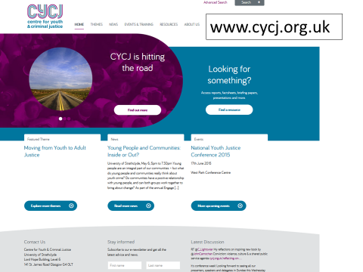
More info
@CYCJScotland
nina.vaswani@strath.ac.uk

