Slide 1

Irish Drugs Policy and the Citizen’s Assembly
Tony Duffin – progressify.ie
SDF #StopTheDeaths Conference
Glasgow - 27th & 28th August 2025

Slide 2
Citizens’ Assemblies to date
2013
2014
2015
2016
2017
2018
2019
2020
2021
2022
2023
01 |
Convention on the Constitution
Voting Age, Presidential Term, Role of Women and Women in Politics, Same Sex Marriage, Electoral Reform, Blasphemy, Right to vote for citizens abroad, Dáil Reform, Economic, Social and Cultural Rights
02 |
Citizens’ Assembly
Abortion, Ageing population, Climate change, The manner in which referenda are held, Fixed Term Parliaments
03 |
Citizens' Assembly on Gender Equality
Gender discrimination, economic and structural pay inequalities, participation and equal opportunities, early years parental care and work-life balance, the social responsibility of care
04 |
Dublin Citizens’ Assembly
Directly elected mayor and local government structures for Dublin
05 |
Citizens’ Assembly on Biodiversity Loss
How the State can improve its response to biodiversity loss
06 |
Citizens' Assembly on Drugs Use
Legislative, policy and operational changes to significantly reduce the harmful impacts of illicit drugs on individuals, families, communities and wider society
Notes:
In terms of cost:
In Ireland, Citizens' Assemblies receive funding from the Department of the Taoiseach. Although the precise expenses of recent assemblies remain undisclosed, it has been reported that the Citizens' Assembly on Gender Equality, which concluded in 2021, incurred a cost of approximately €700,000, excluding staff wages. Subsequent assemblies, such as the one on Drugs Use, are likely to have been even more costly to operate.
CA's in other countries:
Citizens' Assemblies have been conducted in numerous jurisdictions worldwide. An OECD database currently identifies 89 instances of Citizens' Assemblies across different countries, along with 231 cases of citizens’ juries or citizens’ panels. Approaches to organizing a Citizens' Assembly vary significantly.
Regarding the inclusion of communities in the Citizens' Assembly on Drugs Use, they were considered from the outset and prominently featured in the Terms of Reference. Several discussion panels were dedicated to the ‘community perspective.’ While certain community representative organizations, particularly Citywide, were given an opportunity to present their views as stakeholders, individuals working in community settings—such as community development workers and youth workers—were also invited to contribute. Notably, the final discussion panel on 14 May 2023 was specifically focused on community perspectives.

Slide 3
Citizens’ Assemblies – Cost and International Context
Cost in Ireland
Funded by the Department of the Taoiseach
Gender Equality Assembly (2021): Approx. €700,000 (Excludes staff wages)
Drugs Use assembly: Likely more costly, exact figures undisclosed
International Context
OECD Database:
89 Citizens’ Assemblies
231 Citizens’ Juries/Panels
Organisational approaches vary across jurisdictions

Slide 4
Three phases of a Citizens’ Assembly
Phase 03
Phase 02
Reporting
Phase 01
Operation
Establishment
Government initiates the Citizens’ Assembly
Initial proposal typically set out in the Programme for Government
Followed by a Government Decision
Oireachtas formally establishes the Assembly and sets Terms of Reference
Chairperson appointed
Members recruited
Meetings held
Recommendations agreed
Report drafted
Report submitted to Oireachtas
Oireachtas Committee responds to recommendations
Government then responds in detail to the recommendations

Slide 5
Membership
01
100
Members
99 members
An independent Chairperson
02
General Eligibility
All adults normally resident in the state
03
Ineligible Groups
Politicians
Lobbyists
04
Residency
Includes non-citizen residents

Slide 6
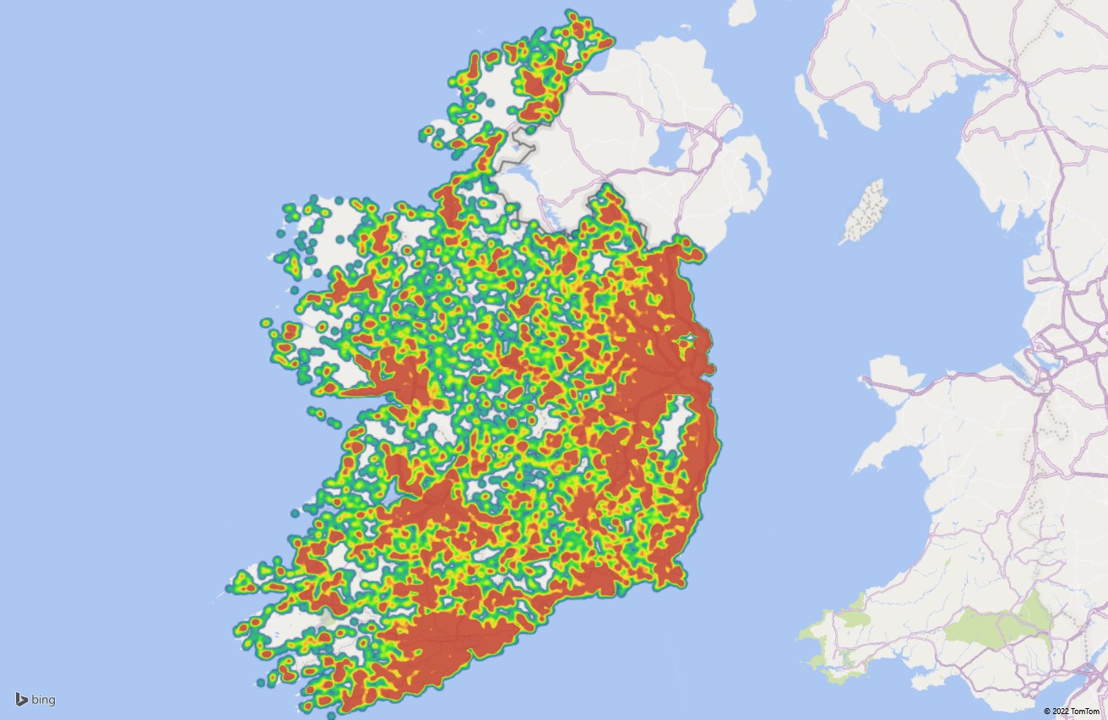
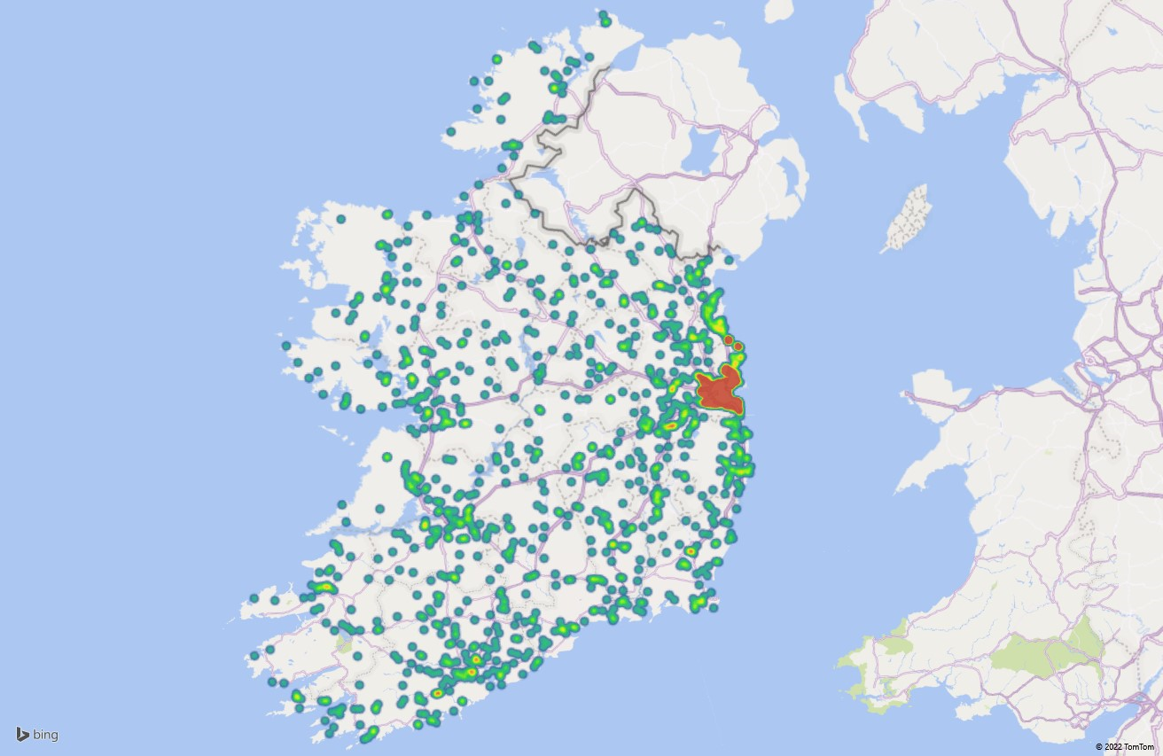
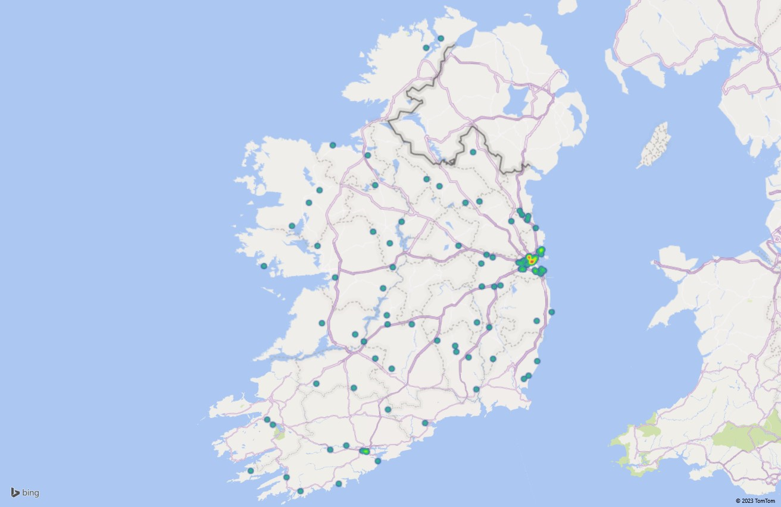
Member Recruitment
RANDOMLY
-SELECTED HOUSEHOLDS
APPLICANTS
RANDOMLY
-SELECTED MEMBERS
20,000
1,500
approx.
99

Slide 7

Demographically representative
Category
Group
Target
Total
Result
Total
DIVERSE & INCLUSIVE
≥ 65 years
20
20
AGE GROUP
45 – 64 years
32
99
32
99
Four people with disabilities, people from a wide range of socio-economic backgrounds, and 15 non-nationals including 11 whose first language was not English.
Other languages spoken included Latvian, Romanian, Polish, Mandarin, Arabic, and French.
25 - 44 years
36
36
18 - 24 years
11
11
Male
49
48
GENDER
Female
50
99
50
99
Non-binary
-
1
Dublin
28
28
LOCATION
Rest of Leinster
27
99
27
99
Munster
27
27
Connacht & Ulster
17
17

Slide 8
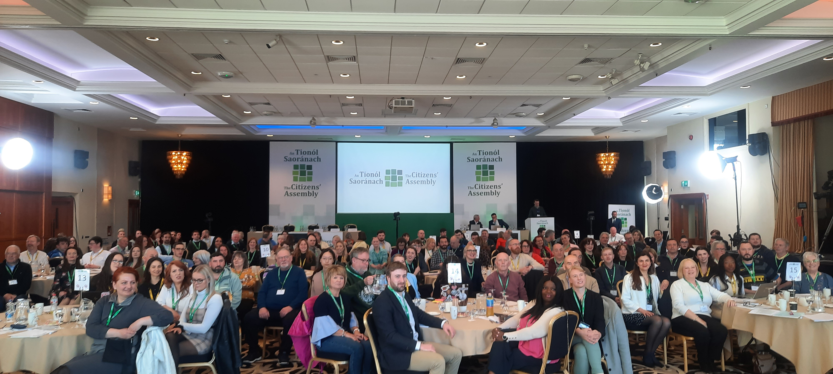
And a wide range of perspectives

Slide 9

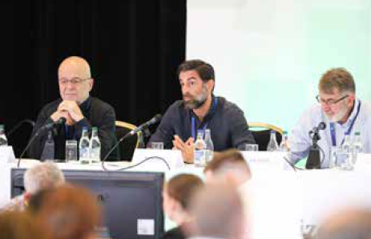
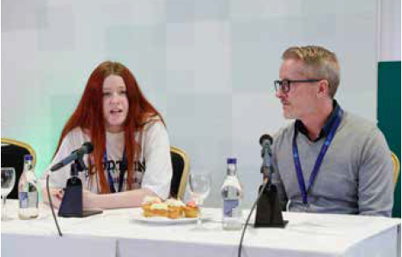
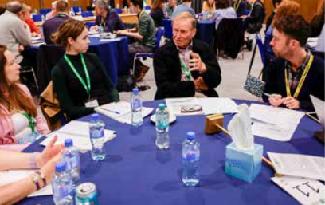
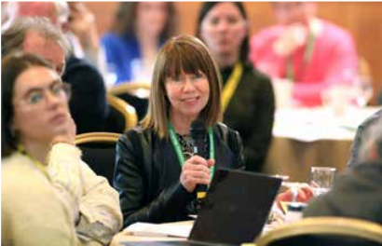
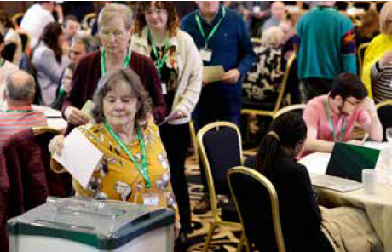
Inputs to proceedings
Site Visits
International case studies
Good practice examples
Site visit to Coolmine
Dr. Alfred Uhl,Mr Nuno Capaz
and Mr. Jim Walsh
Clondalkin Drug and Alcohol Task Force Precention Model – Sive Brennan, Trevor Bissett
Roundtable discussions
Q&A
Democratic decision-making
Roundtable discussions
Questions and Answers
Members Vote

Slide 10
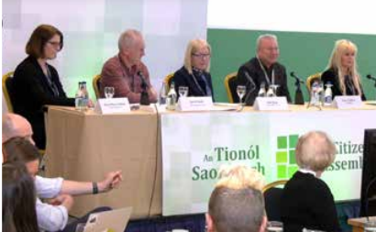
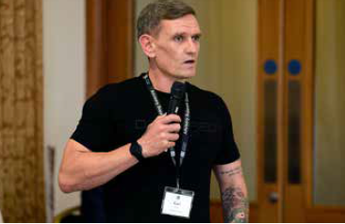
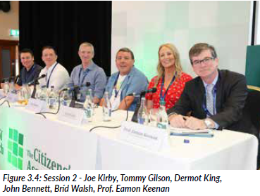
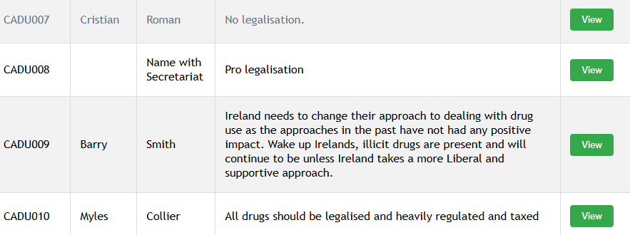
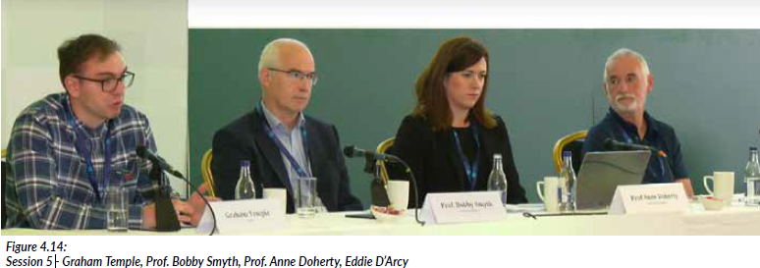
Inputs to proceedings
Expert inputs
Lived experience inputs
Service Providers
Session -Prof. Mary Cannon, Joe O‘Neill, Judge Ann Ryan, Paul Griffiths, Prof. Jo – Hanna Ivers
Contributuon from Karl Ducque
Session 2- Joe Kirby, Tommy Gilson, Dermot King, John Bennett, Brid Walsh, Prof. Eamon Keenan
Submissions to public consultation
Advocates and campaigners
Roundtable discussions
Session 5- Graham Temple, Prof. Bobby Smyth, Prof. Anne Doherty, Eddie D’Arcy

Slide 11
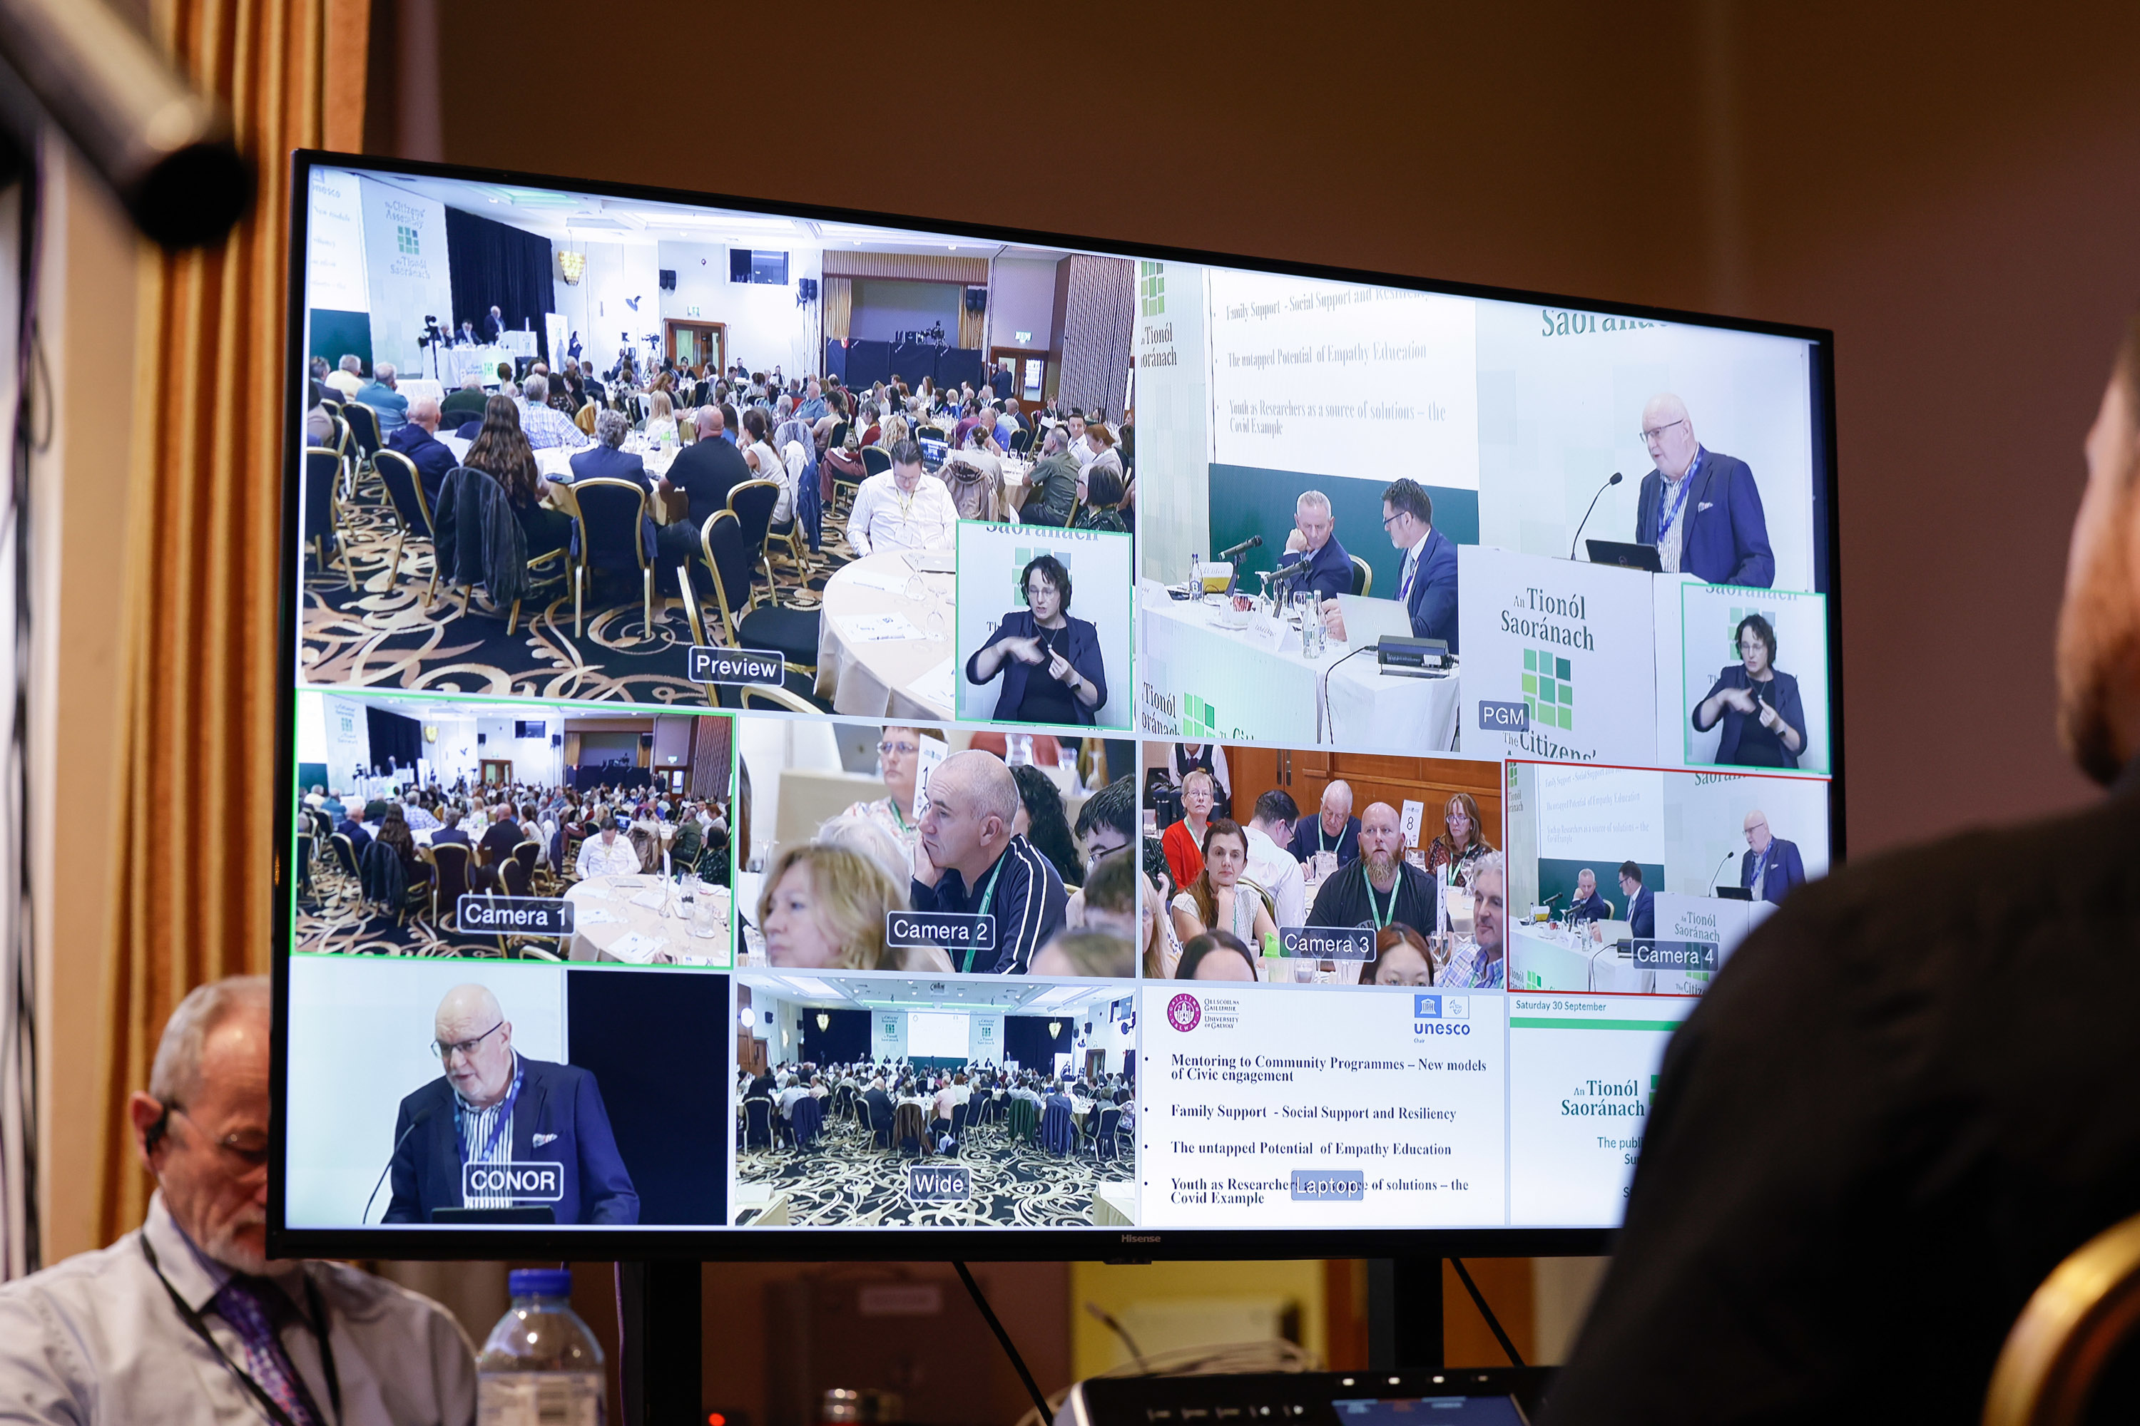
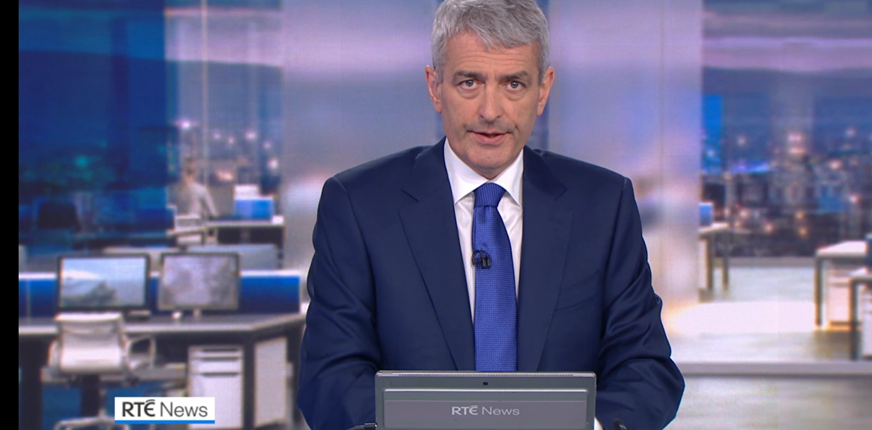
Coverage
ALL PUBLIC
PROCEEDINGS LIVESTREAMED
EXTENSIVE
MEDIA COVERAGE

Slide 12


Recommendations on drugs use
Oireachtas Committee
Citizens’ Assembly
Government response
59
36 recommendations
2025
additional
recommendations
Span the full spectrum of drug policy issues
Onwards
Prevention, harm reduction, treatment and recovery
Examine implications of drug use on individuals, families, communities and wider society

Slide 13
The deliberative process
01
Clear governance, with rules, procedures and guiding principles to protect the integrity of the process
02
Strident efforts to ensure fairness and balance of proceedings, with high-quality deliberation, supported by professional facilitators, ensuring equality of voice and respect for all viewpoints
03
Ongoing quality control, monitoring of deliberative conditions
04
Members’ feedback systematically obtained
05
Lobbying not allowed, and external pressures mitigated against

Slide 14



Quality Control and continuous improvement
Members
detailed evaluation data provided following each meeting
Advisory Support Group
Lived Experience Group
Facilitators
Steering Group
Deliberative Democracy expert
INFORMED BY REGULAR, SYSTEMATIC FEEDBACK

Slide 15
Citizens Assembly on Drugs Use
| April to October 2023
January
February
March
April
May
June
July
August
September
October
November
December
Purpose
Membership
Process
Examine drug policies
Gather evidence
Develop recommendations for reform
Reflective of the general population
Selected to ensure diverse demographics
Members learn from experts and people with lived experiences
Then deliberate in small groups and larger sessions
A FINAL REPORT WITH RECOMMENDATION SENT TO POLICYMAKERS FOR CONSIDERATION
Notes:
Recap slide.
Potentially furthering progressive drug use policy (Harm Reduction, Health Led, etc.)

Slide 16
Post–Citizens’ Assembly on Drugs Use
Timeline & Next Steps
Oct 2023 – Citizens’ Assembly agrees 36 recommendations
Dec 2023 – Final report submitted to Government
June–July 2024 – First Oireachtas Committee holds hearings
22 Oct 2024 – Interim Committee report published
29 Nov 2024 – General Election held
18 Dec 2024 – 34th Dáil convened
23 Jan 2025 – New Government of Ireland formed
May 2025 – New Oireachtas Committee on Drugs Use established
Sept 2025 – Public hearings begin → final report due by June 2026

Slide 17
4 years 9 months gap?
Civil Service and Political Processes
Citizens’ Assembly Report submitted: December 2023
New National Drugs Strategy (NDS): To be published before end of 2025
Oireachtas Committee Final Report due: May 2026
Government Response to Committee: Q4 2026 (post-summer recess)
NDS Mid-Term Review: circa Q3 2028
Time Gap
From: Citizens’ Assembly Report (Dec 2023)
To: Government response included in NDS Mid-Term Review (circa Q3 2028)
Total Gap: 4 years and 9 months Implication
Government response to Citizens’ Assembly recommendations will be delayed
Government response will not be reflected in the initial NDS
First opportunity for integration: Mid-Term Review in 2028
Highlights a mismatch between strategy development and political input
Of course, there has been consultation for the new NDS, and the recently established NDS Drafting Committee is aware of the recommendations from the CA on Drugs Use.
Notes:
Precedent for an interim strategy: The 2009 strategy was originally presented as an interim strategy to provide a framework for action while a more comprehensive, integrated substance misuse strategy—including alcohol—was developed. However, in practice, it effectively served as Ireland’s main national drugs policy framework for several years until it was succeeded by the Reducing Harm, Supporting Recovery 2017–2025 strategy, which fully integrated drugs and alcohol policy. So, while it was initially labelled interim, it functioned as the primary strategy until replaced in 2017.

Slide 18
Drug Policy in Ireland: Progress and Challenges
National Drug Strategy under development.
Critical Partners: Civil Society involvement in the field of Drug Policy (C-EHRN report 2024)
Decriminalisation: Many Civil Society actors and Political advocates remain committed.
New Health Diversion Scheme: initiative to be rolled out in Nov 2025 - as reported in the Irish Examiner.
Pilot Supervised Injecting Facility: evaluation.
Dublin Drug Treatment Court: evaluation.
Back-of-house Drug Checking is available at two festivals this year.
Long-acting injectable buprenorphine (Buvidal) is currently prescribed via HSE clinics.
Whilst much work has been done to improve access, Naloxone remains a prescription-only medication in Ireland.
Notes:
Wide range of issues - this slide offers examples to talk to.

Slide 19
Further information
Links
Home | Citizens' Assembly
Citizens' Assembly on Drugs Use - Wrap Up Video
Ministers for Health publish independent evaluation of the National Drugs Strategy

Slide 20
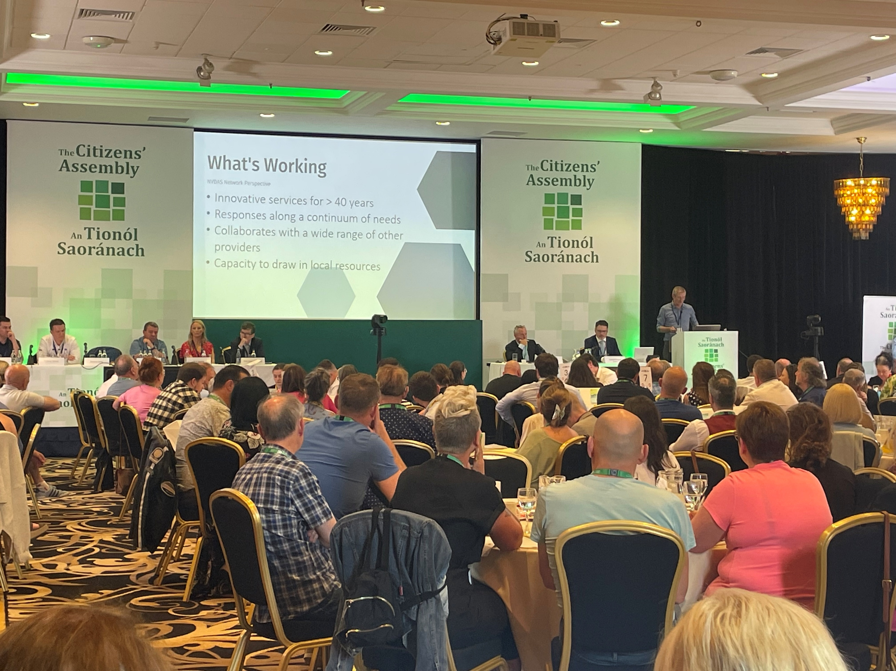
Thank you – any questions?

